Slide 1
Star-Formation Rate in Low-Redshift Clusters of Galaxies
Ali Khan

Slide 2
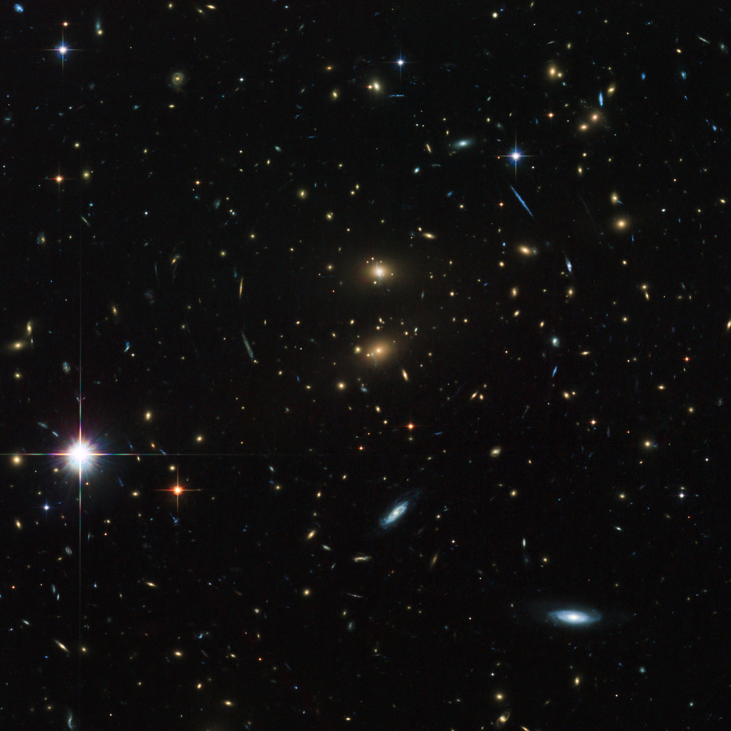
What are Clusters of Galaxies?
Structures that consist of hundreds of galaxies bound together.
Are the largest gravitationally bound structures in the universe.
While dynamically stable, they may still be growing by accreting galaxies from the surrounding field.

Slide 3
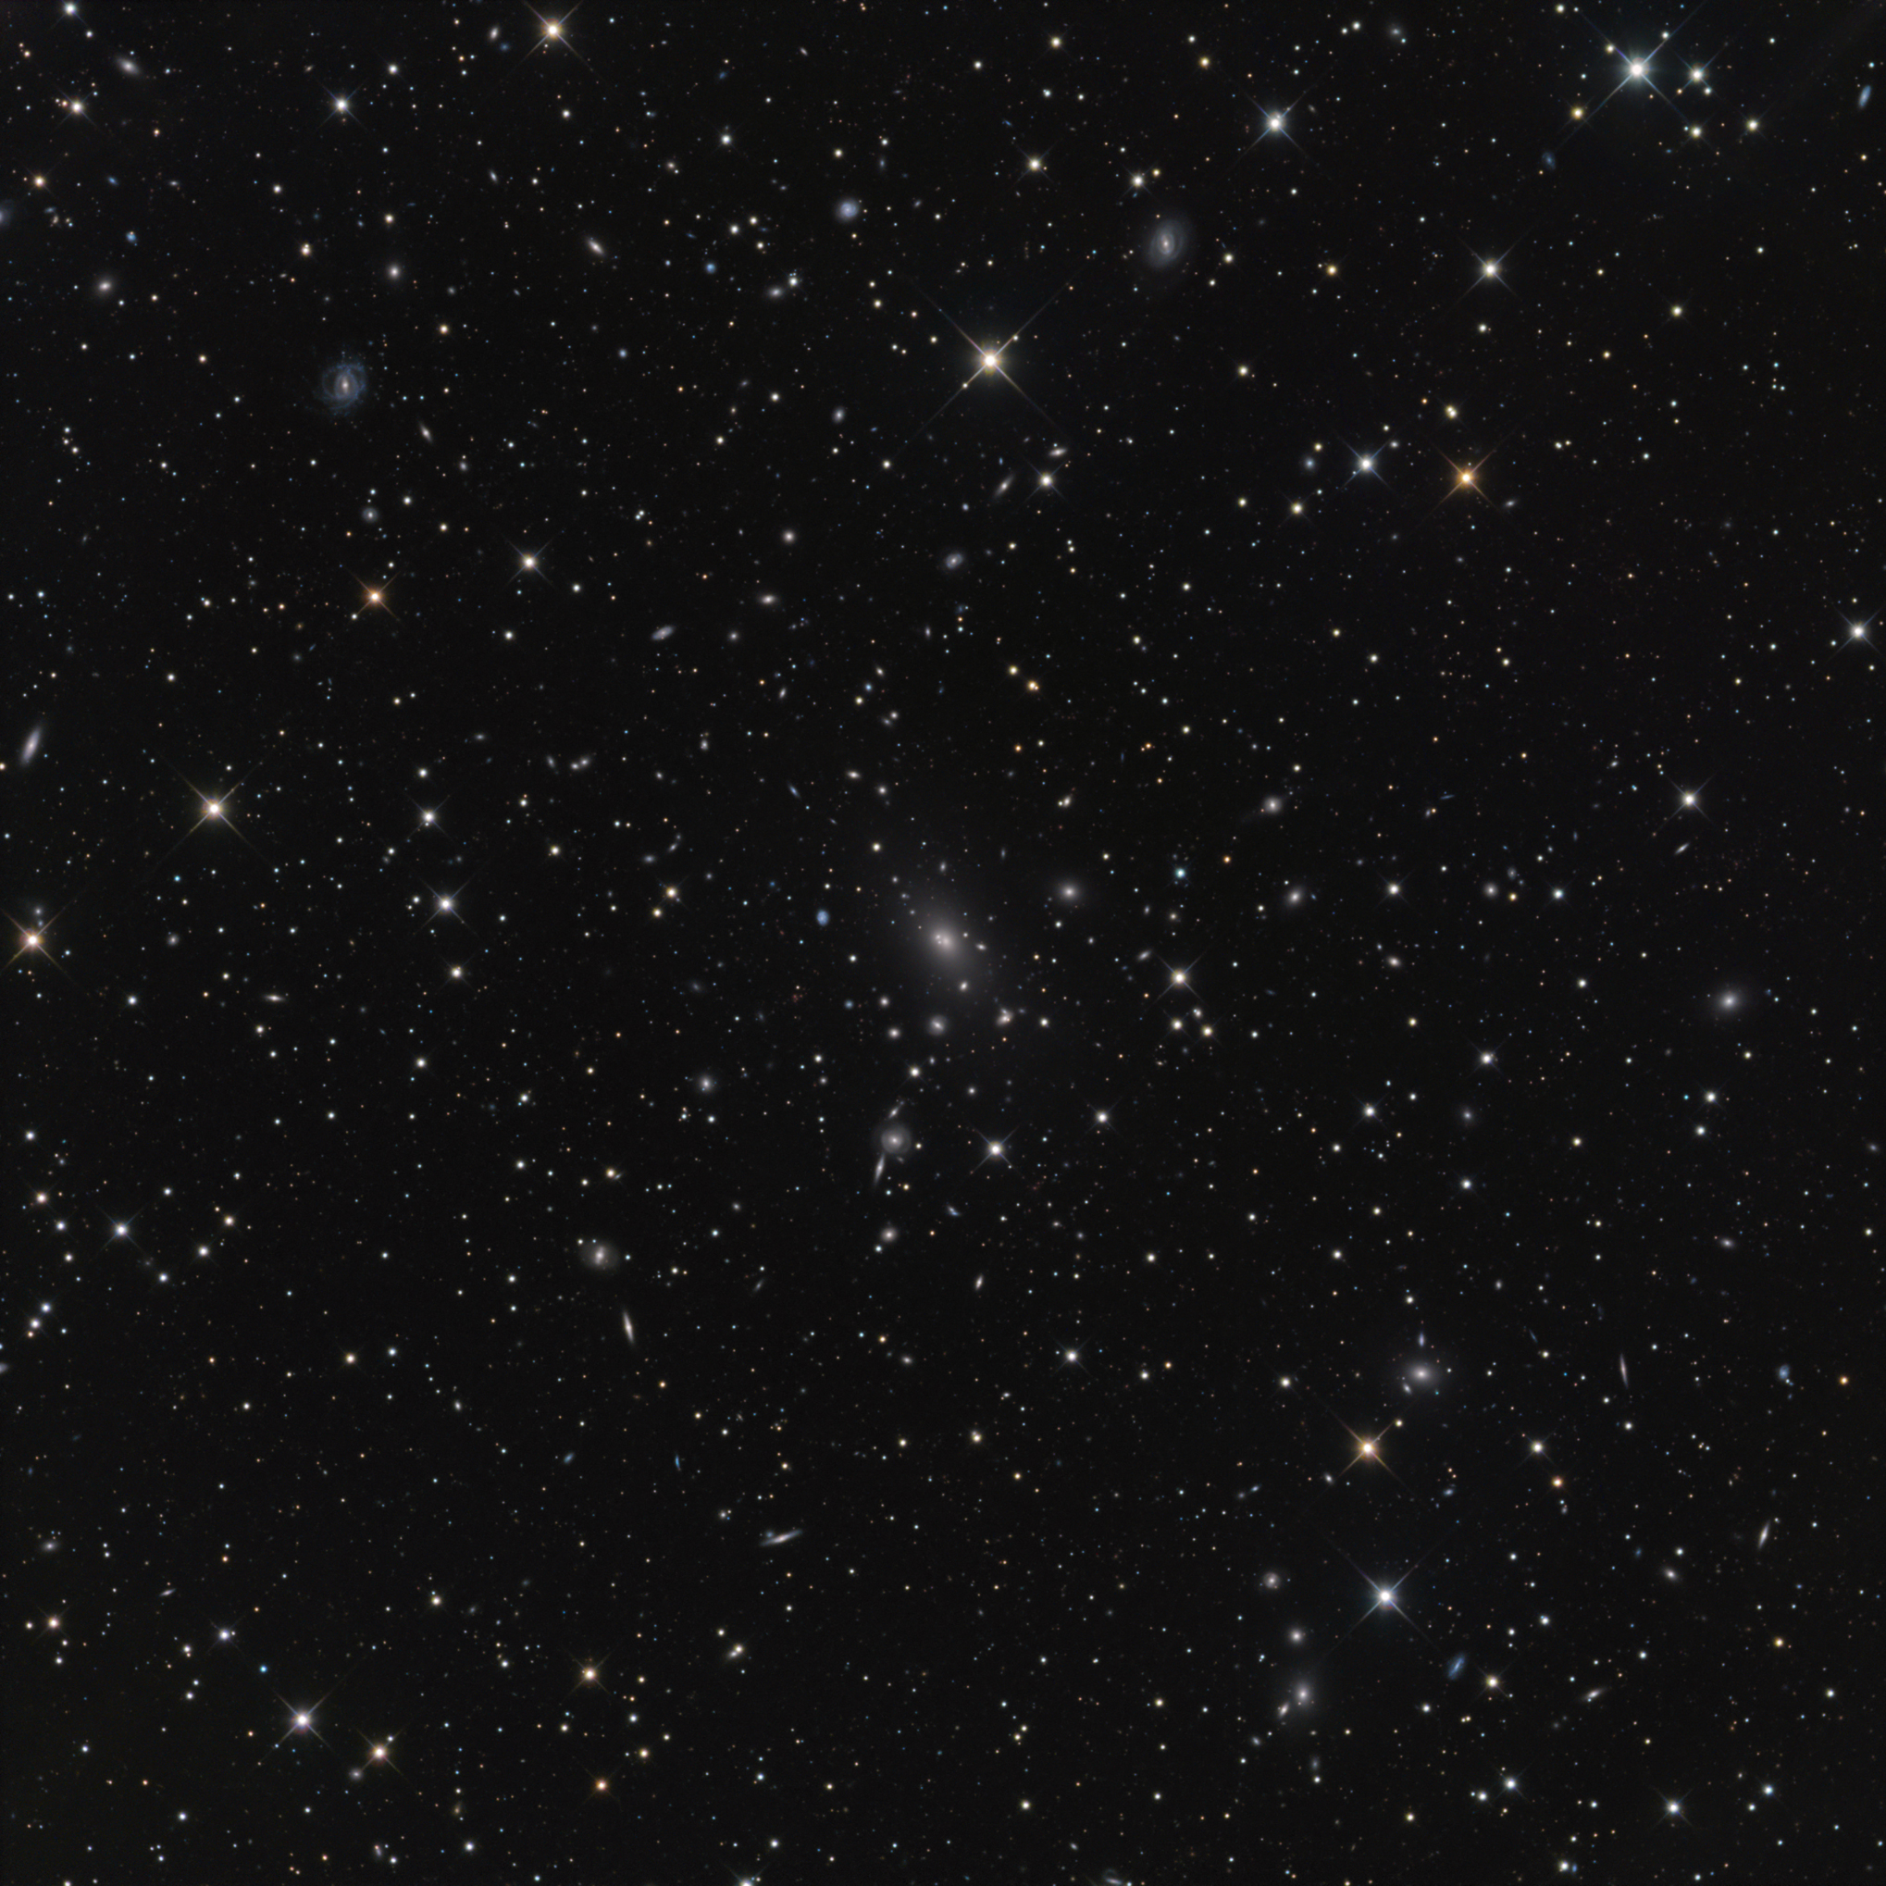
Motivation
Study how properties of galaxies are correlated with their environment in clusters of galaxies.
Understand the evolution of galaxies within clusters.

Slide 4
How are we doing this?
Match multi-wavelength data sets.
Build Spectral Energy Distributions for galaxies.
Because of multi-wavelength nature of data, the techniques used for building SEDs can be employed in the analyses of the Near-Infrared Camera for JWST.

Slide 5
Background
Spectral Energy Distribution (SED)
Depicts relationship between frequency of light and flux of the observed object.
Each galaxy can be characterized by an SED.
Younger stars emit in the bluer parts of the spectrum, whereas older stars are brighter in the red.
The SED can tell us the average stellar composition for a given galaxy.

Slide 6
Methodology
Use software to match images in different wavelength bands. Ranging from the ultra-violet domain to the infrared region.
Use two Different Methods
Catalog Matched Photometry (SYNMAG)
PSF Matched Photometry

Slide 7
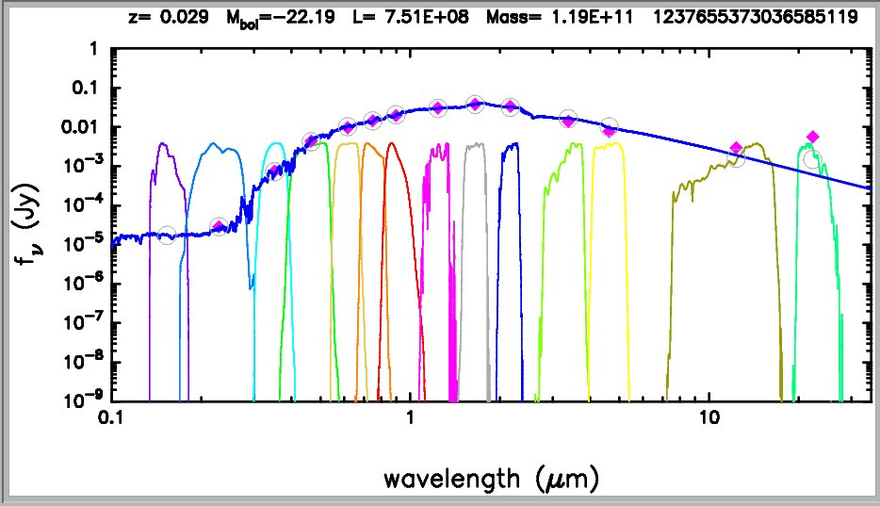
Catalog Matched Photometry
Used pre-existing code to carry out matched photometry on the catalog level.
Bundy et. al 2012
SEDs were built using profile fitting.
Method is very quick and requires no image processing, but is sensitive to matching errors and catalog imperfections

Slide 8
PSF Matched Photometry
Alternative to catalog matching.
Uses actual images.
The process calls for the integration of many different programs.
Source EXtractor to detect sources
Galapagos to perform Sersic fitting and produce output catalog for images
PSFex to obtain PSF of the image to be fitted
PyGFit to carry out the PSF matched photometry
Automation is required to make procedure more efficient and less error prone.

Slide 9
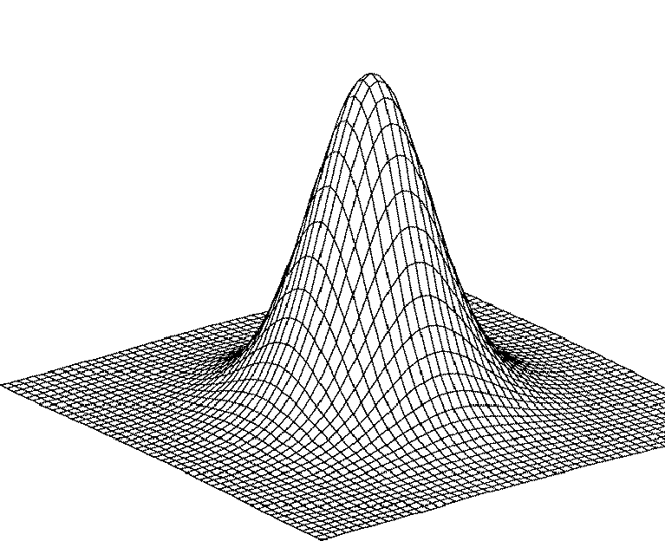
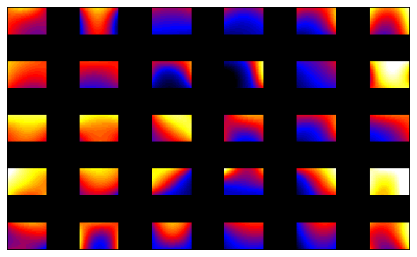
Point Spread Function (PSF)
Describes the response of an imaging system to a point source.
Different wavelength bands are described by
different PSFs.
Varying colors show the PSF width across a CCD chip used in SDSS

Slide 10
PSF Matched Photometry
Broadening Function
High Resolution PSF
Low Resolution PSF

Slide 11
Conclusion
The results from catalog matching were showing biases in the ultraviolet results.
Need to employ another method.
Currently writing Python scripts to automate the whole procedure of fitting images and doing the book keeping.
Carry out actual photometry on the images.
What is the improvement factor?
Carry the procedure out on multiple wavelength bands.

Slide 12
Final Thoughts / Future Work
The idea of using this procedure of fitting images in different wavelength bands together is to measure the magnitude of a given source in exactly the same region to0 build SEDs.
Once this script is complete we plan on running this on images in wavelength bands ranging from the near-ultraviolet all the way to the far-infrared.
We will be able to build SED profiles for multiple galaxies across a large wavelength range.
This will give us a better understanding of the characteristics of a given galaxy over a very wide wavelength range.

Slide 13
Thank you
Questions?
Thank you.
Any questions?

Slide 14
PSF Matched Photometry
Images were used from the Sloan Digital Sky Survey.
A tile from the r-band was used as a reference image.
For test purposes, we chose the reference image to be the exact same as the one being fitted.
This test would allow us to get a better understanding of our procedure.

Slide 15
Results
We saw a linear correlation between the fitted image as well as the input image.
This is what we would expect.
This procedure allowed us to realize that our methodology was giving us sensible results.

Slide 16
How PyGFit Works?

Slide 17
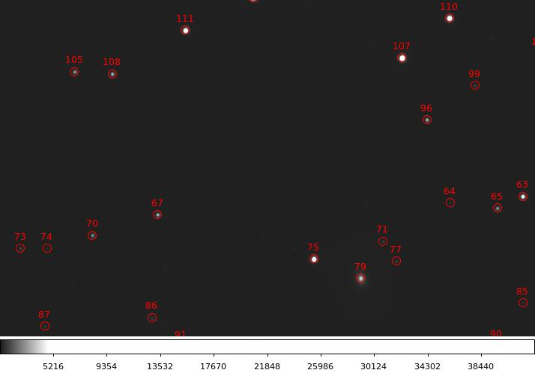
How PyGFit Works?
Looks at an image tile.
Takes the image of the same tile in two different wavelength regimes
Detects sources using program: Source EXTRACTOR
After detection, it matches the co-ordinates for the images being matched.
The reference image (of higher resolution) is convolved with the PSF of the lower resolution image.
The magnitude in that band is extracted.
SED can be built based on extracted data

Slide 18
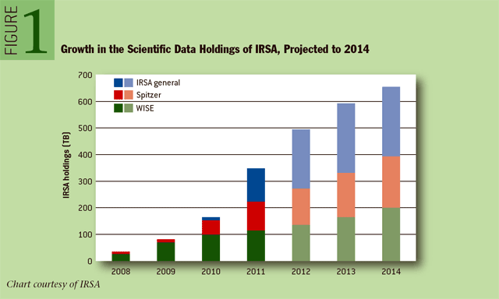
Motivation
Astronomy is entering an era of deep imaging surveys.
Surveys include SDSS, DES, HSC and many more.
We have and will continue to receive large amounts of data on rapid timescales.
We need fast and reliable methods for combining this information.
http://queue.acm.org/detail.cfm?id=2047483

Slide 19
Conclusion
I came into the program knowing very little astronomy.
I had no intuition on how to use idl, unix or python.
However, in retrospect
Better understanding of general astronomy.
Improved skills in data processing.
Familiarity with / introduction to multiple coding languages.

